Slide 1
PiK UI Draft
4/29/14

Slide 2

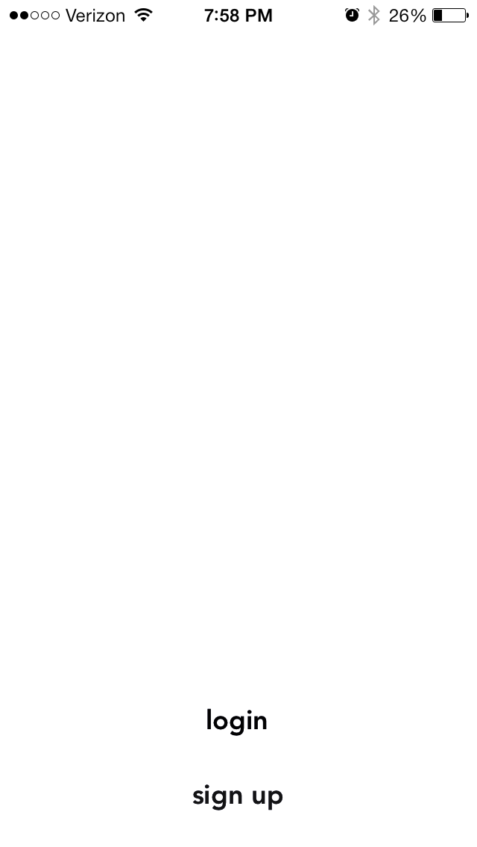
Leverage stronger networks
O O O O
Log In | Sign Up

Slide 3
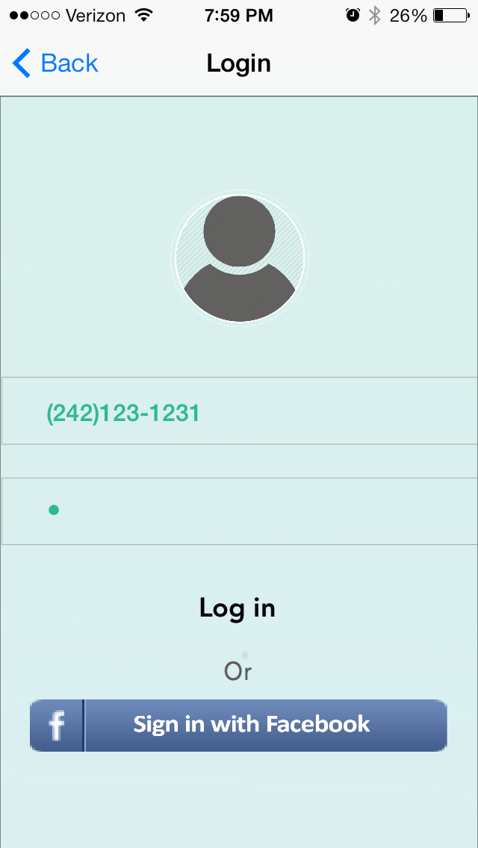
Log In
Email
Password
Submit
Back

Slide 4
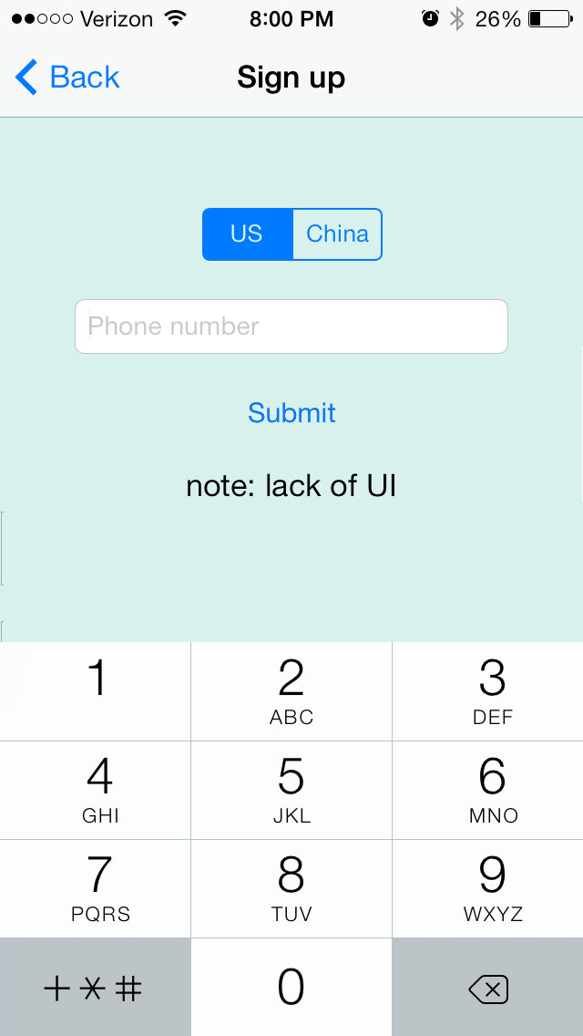
Sign Up
USA
China
Phone Number
Submit
Back

Slide 5
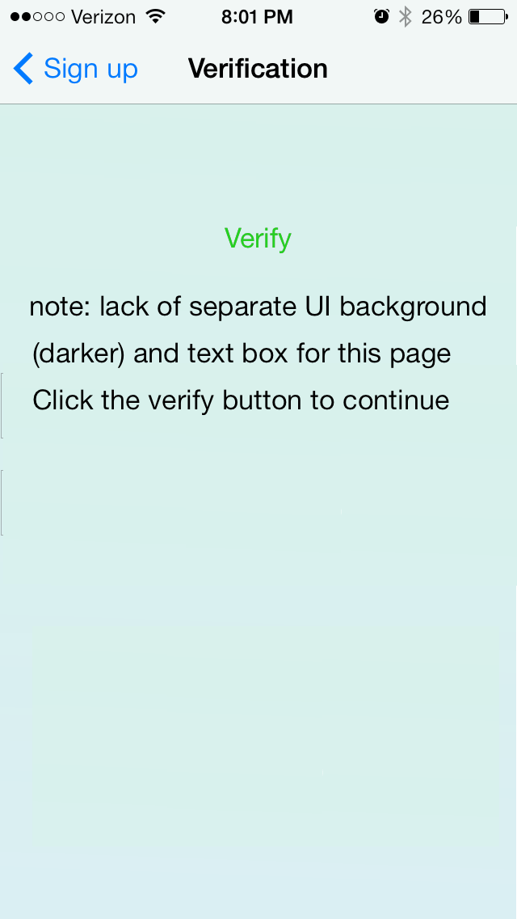
Verification
Enter the SSM code
xxx-xxx
Verify
Back

Slide 6
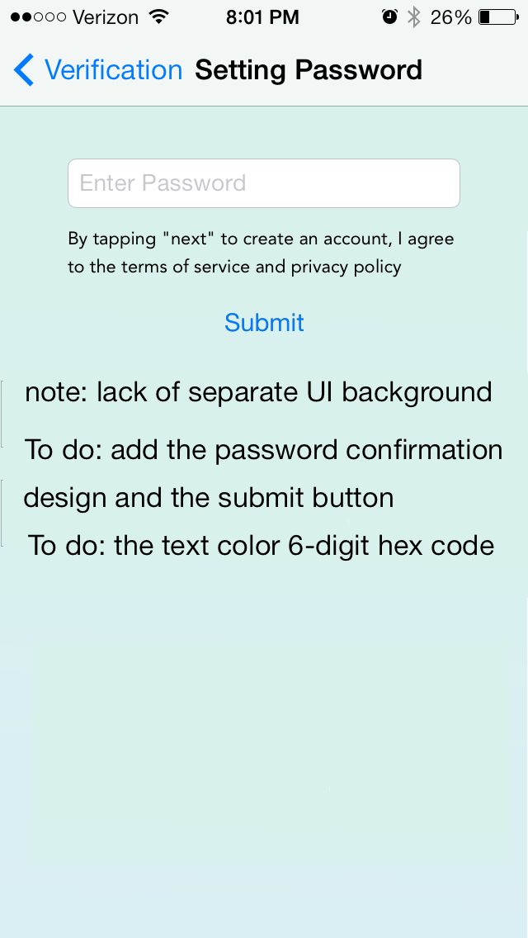
Setting Password
Enter Password
Re-enter Password
By tapping submit to create an account, I agree to the terms of service and privacy policy
Submit
Back

Slide 7
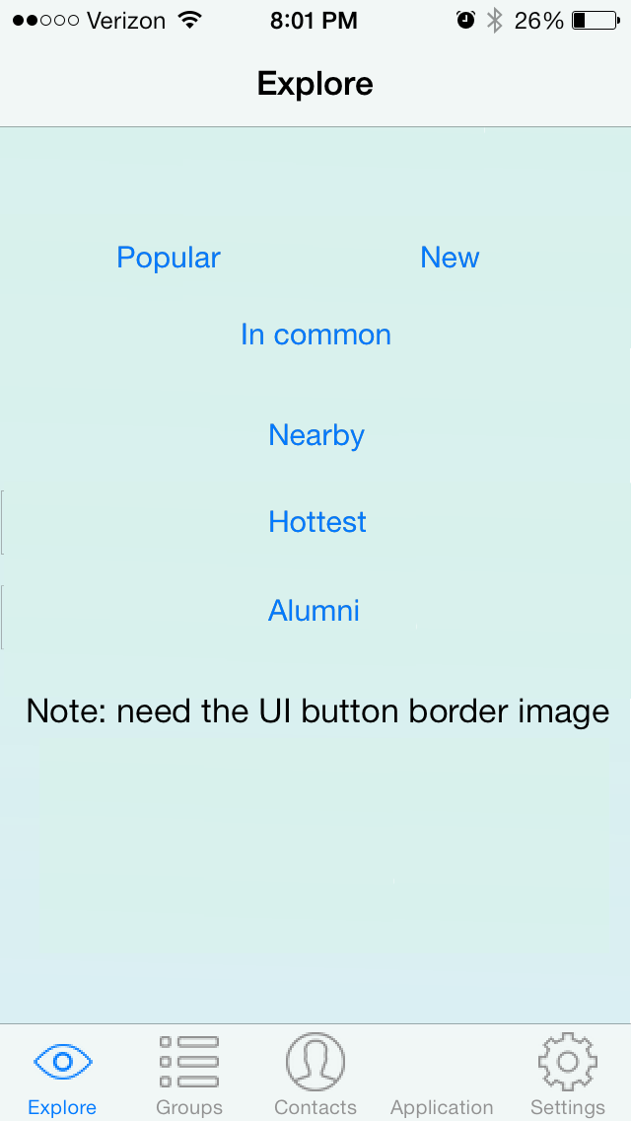









Explore
Popular
New
Explore | Groups | Contacts |  | Settings
Request

Slide 8
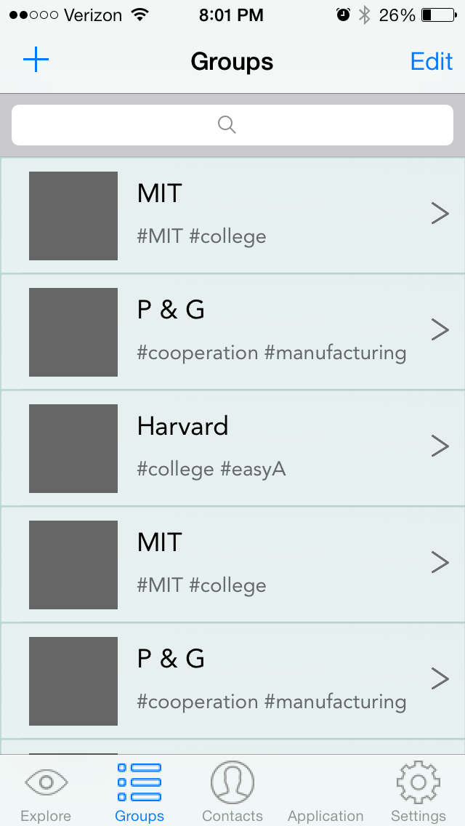
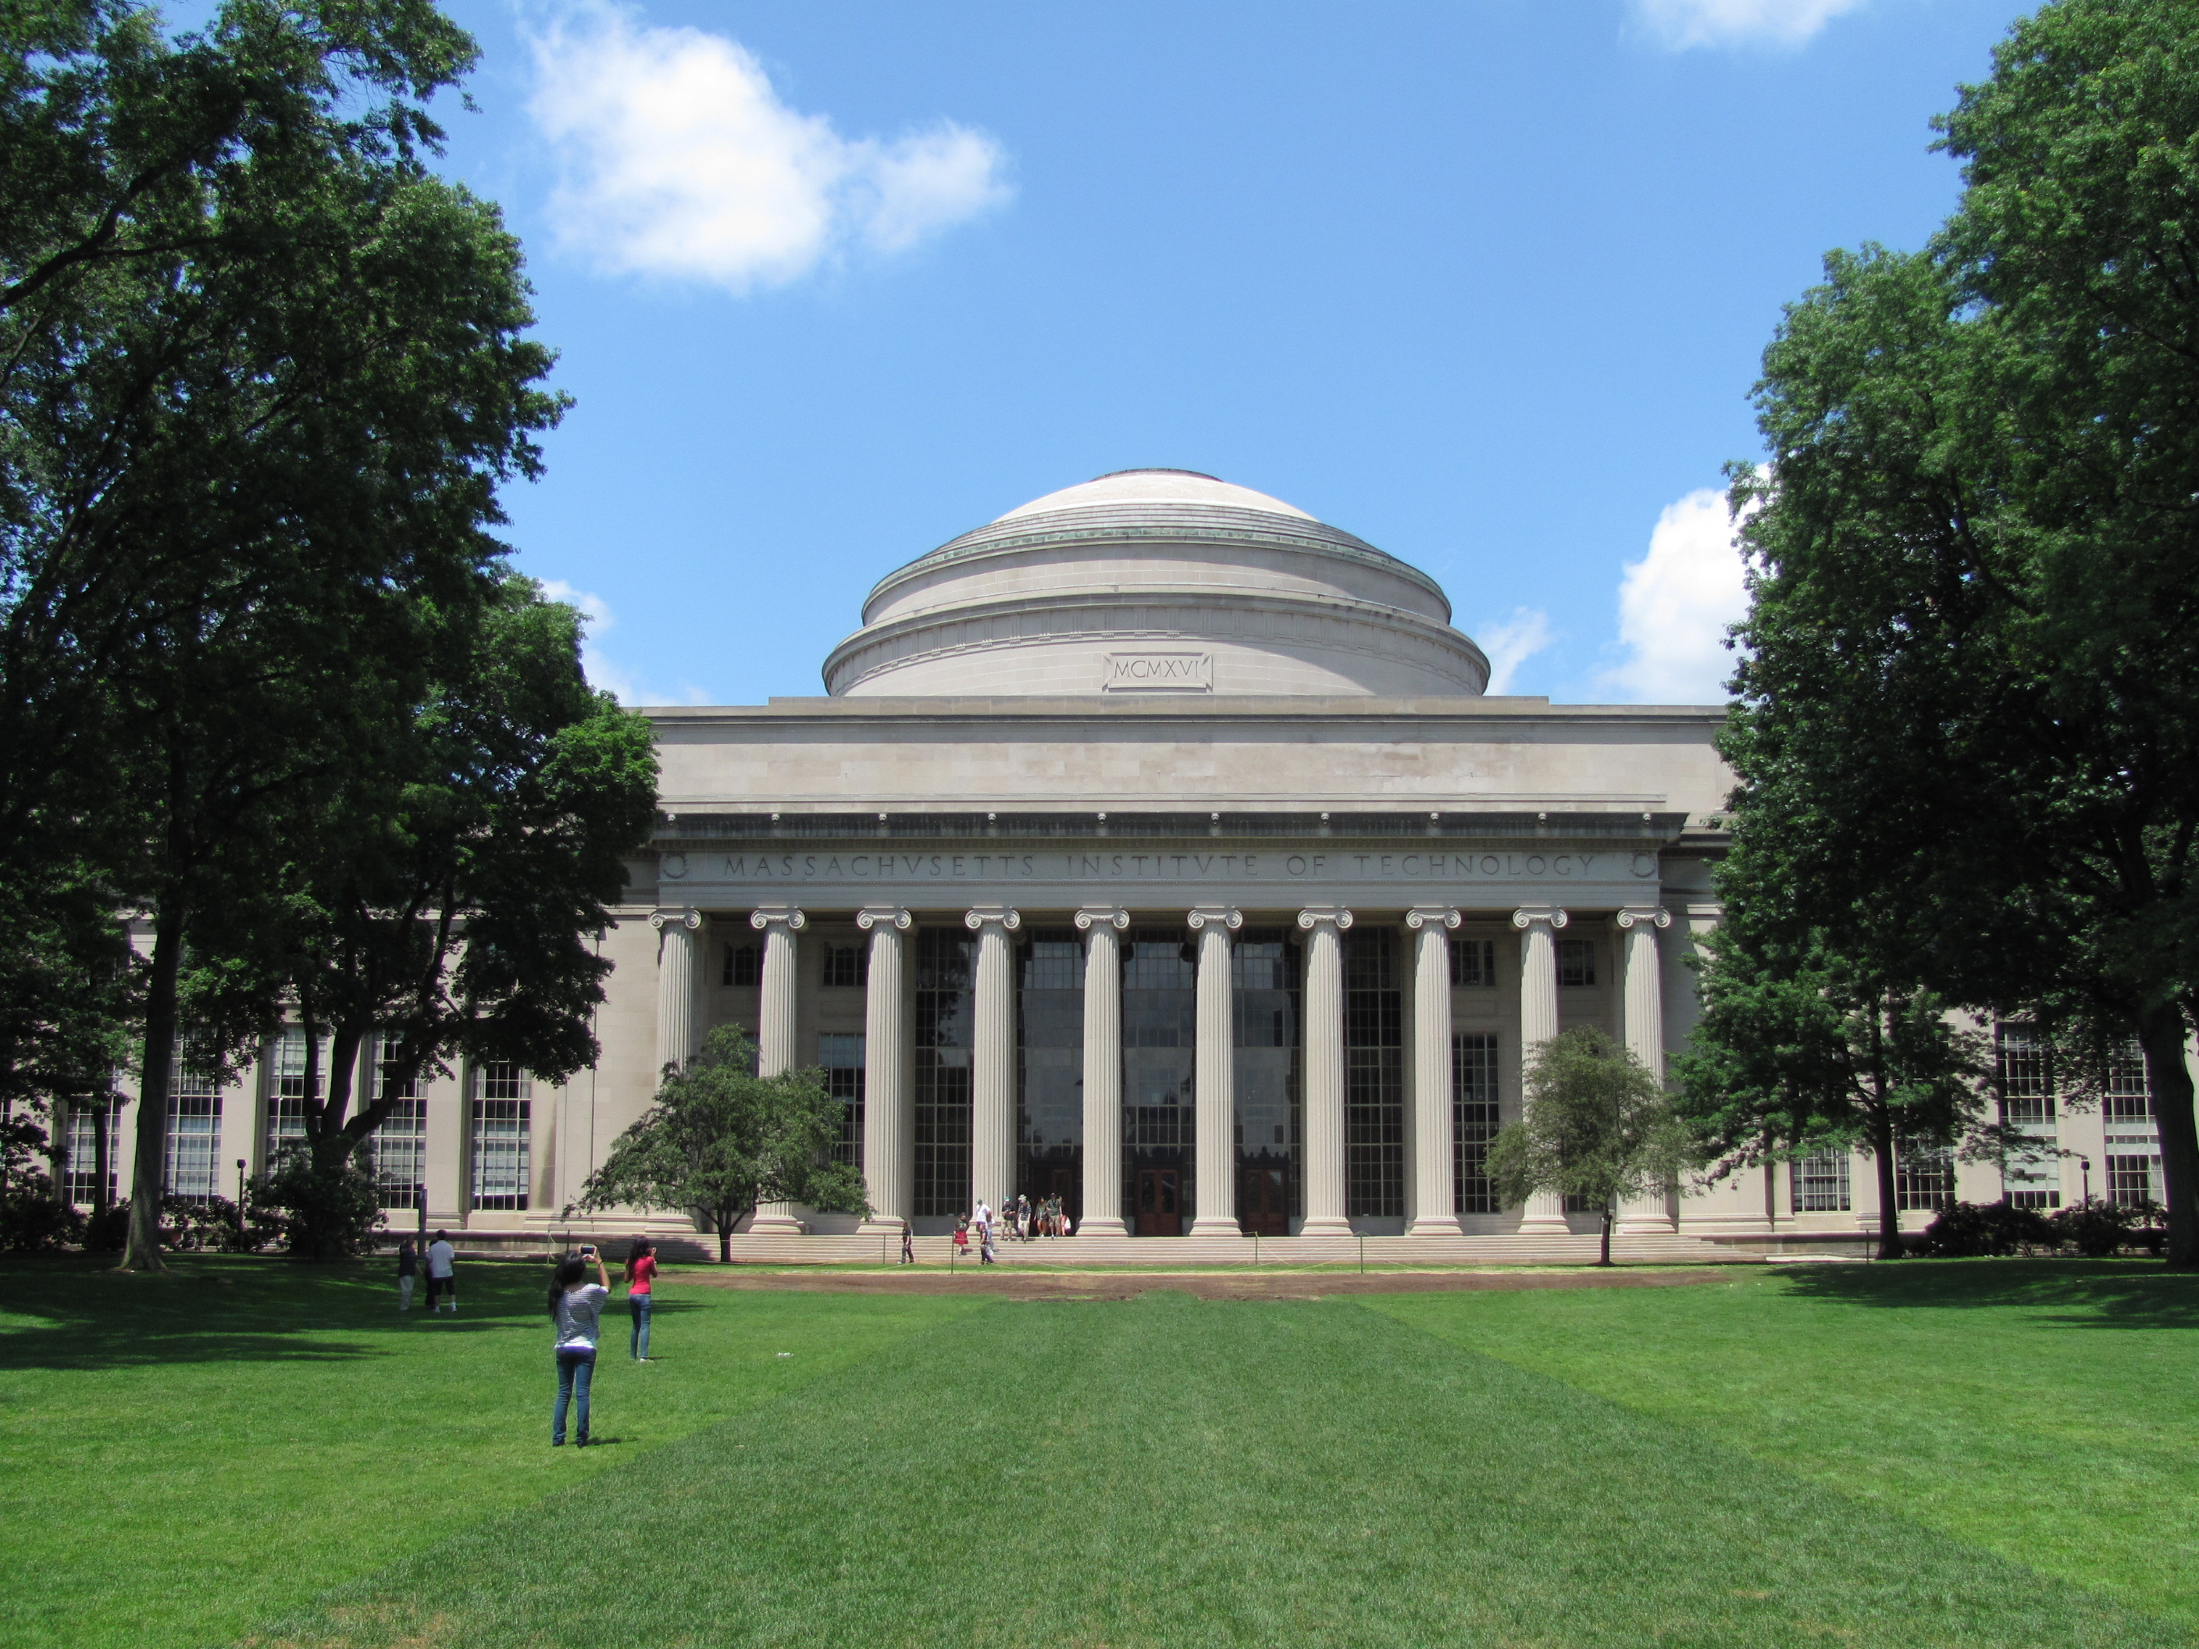
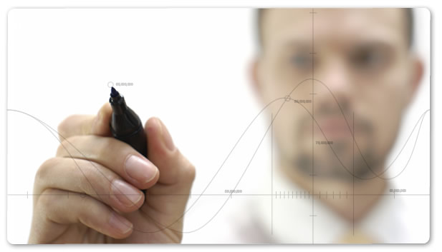

+
Groups
Edit
search
MIT
65 newbies # MIT # College
Consulting
23 newbies # MIT # College
Programming
Explore | Groups | Contacts |  | Settings
Request

Slide 9

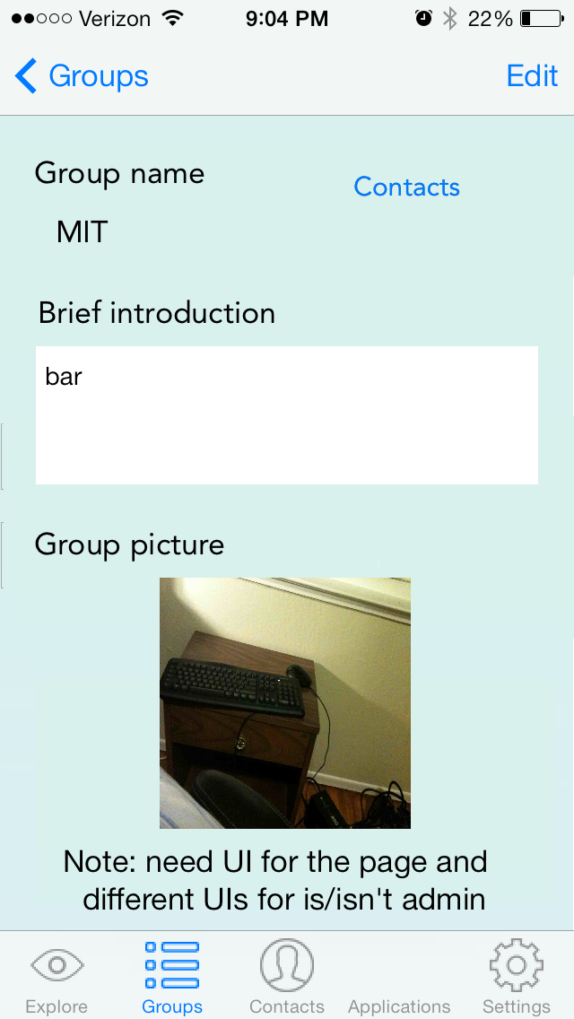
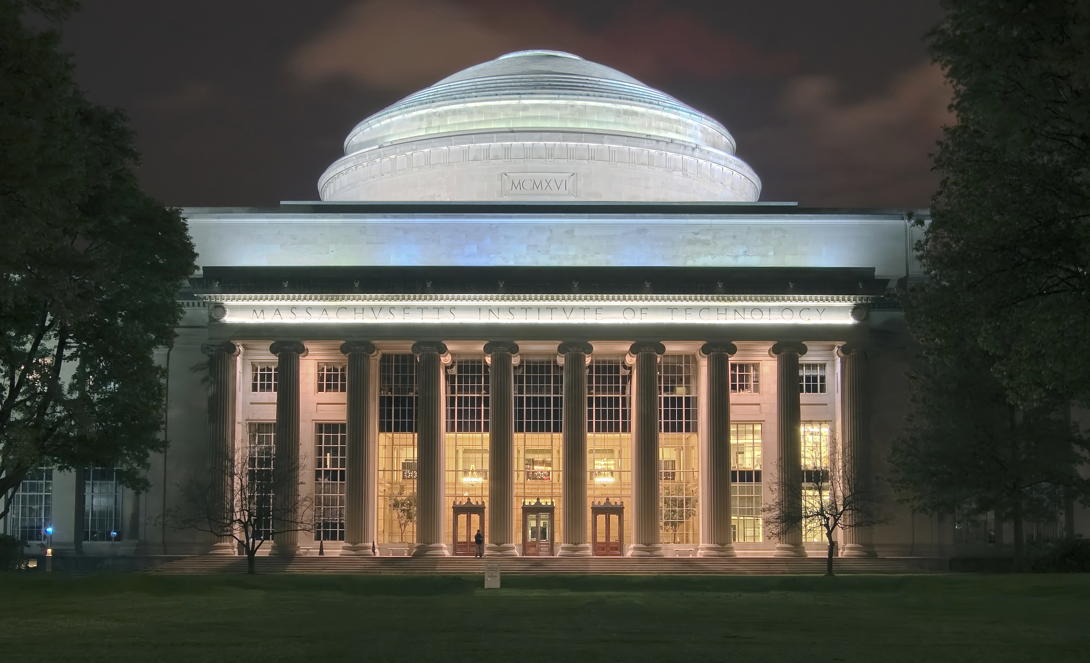

< Groups
+
MIT
#tech #research #science
April 20th
MIT 100k Accelerator Pitch
RSVP
View
1243 Members 42 Connections
Explore | Groups | Contacts |  | Settings
Request

Slide 10
<
< Groups
+
MIT
… your friends are here
?
Diana H.
Eric C.
Request to Join
Explore | Groups | Contacts |  | Settings
Request

Slide 11
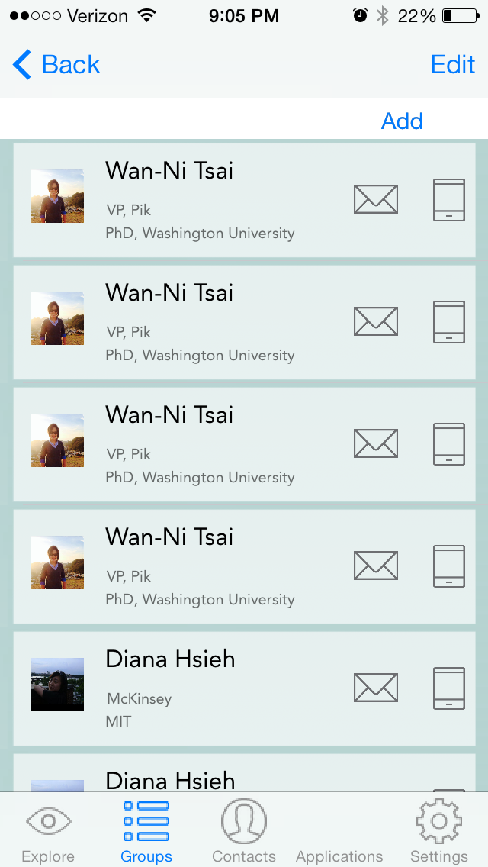

< Back
Edit
+
MIT
Eric Chang
#cs #microsoft
Diana Hsieh
#econ #NYC
Wanni Tsai
#mechE #tech
Explore | Groups | Contacts |  | Settings
Request

Slide 12
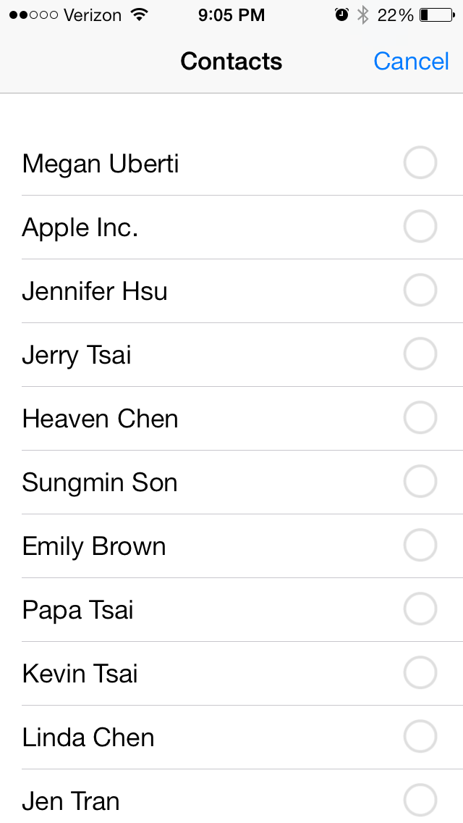

Slide 13
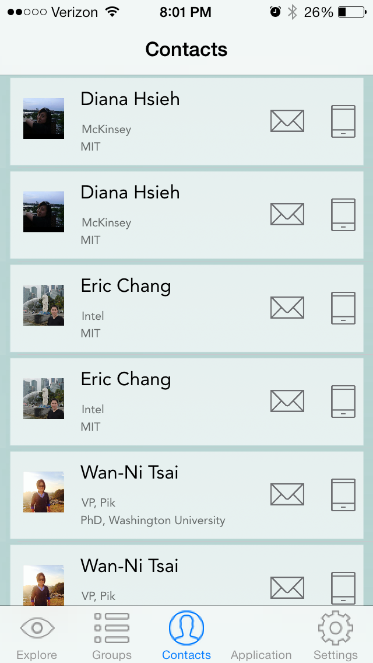
+
Contacts
Search
Eric Chang
#cs #microsoft
Diana Hsieh
#econ #NYC
Wanni Tsai
#mechE #tech
Explore | Groups | Contacts |  | Settings
Request

Slide 14
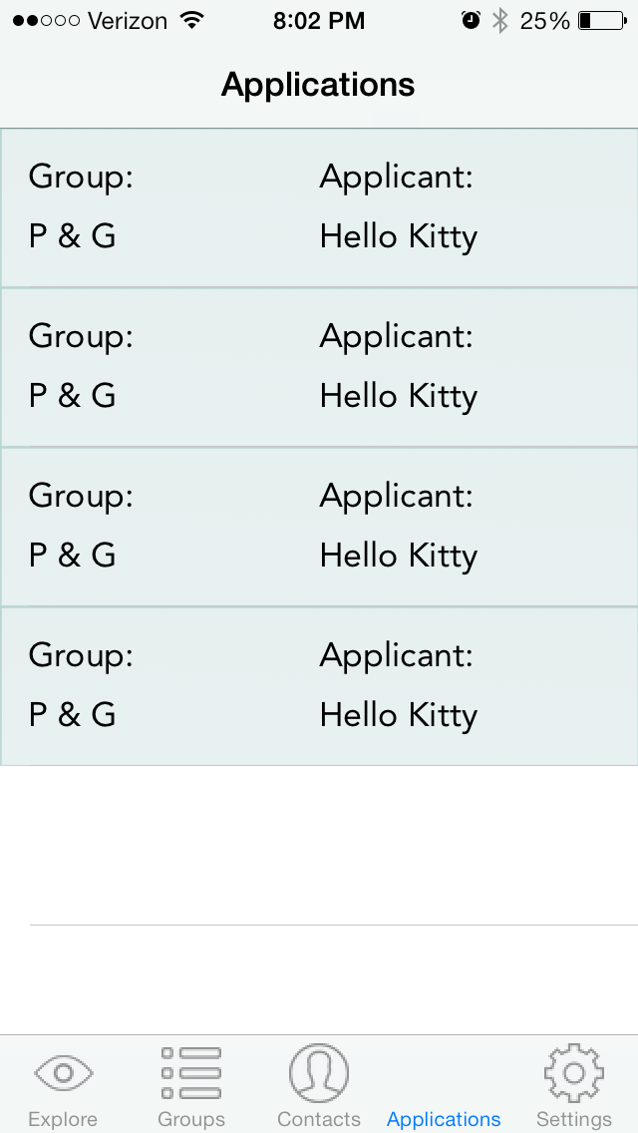
Requests
Group | Requester
P&G | Hello Kitty
Caltech | Beaver R
Explore | Groups | Contacts |  | Settings
Request

Slide 15
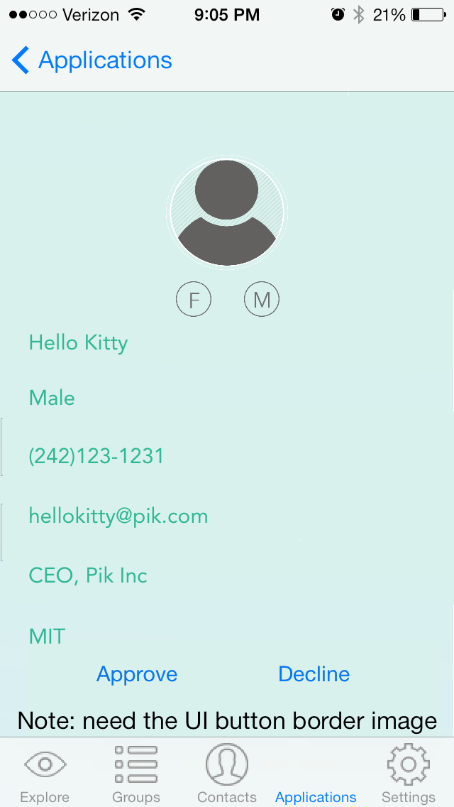






Request
< Back
Tim Beaver
MIT
Morgan Stanley Investment Banker
dianasaur@pik.com
407-490-9048
Explore | Groups | Contacts |  | Settings
Request

Slide 16
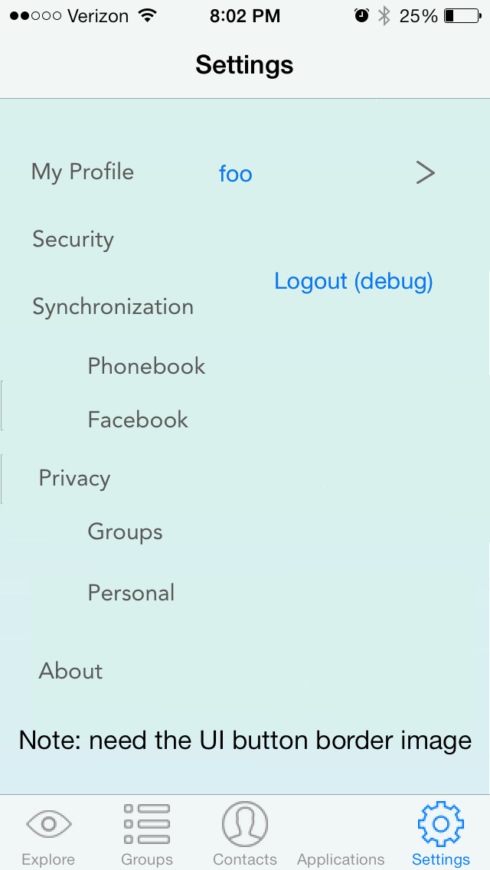
Settings
My Profile
Foo >
Security
Sync
Phonebook
On
Facebook
Off
Privacy
Groups
On
Personal
Off
About PiK
Explore | Groups | Contacts |  | Settings
Request

Slide 17
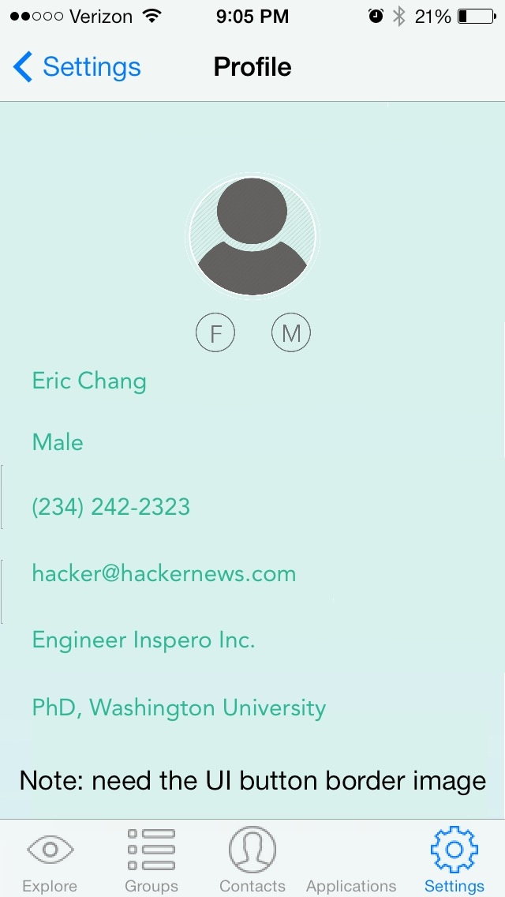
Profile
< Settings
Tim Beaver
MIT
Morgan Stanley Investment Banker
dianasaur@pik.com
407-490-9048
Explore | Groups | Contacts |  | Settings
Request

Slide 18
Junk Yard

Slide 19
Log In
Sign Up
Phone Number
USA
China
Password
Phone Number
Submit
Submit
Facebook Log In
Back
Back

Slide 20
Verification
Sign Up
USA
China
Enter the SSM code
Phone Number
xxx-xxx
Submit
Verify
Back
Back

Slide 21
Log In
Email
Leverage stronger networks
Password
Submit
O O O O
Log In | Sign Up
Back

Slide 22
Setting Password
Enter Password
Re-enter Password
By tapping submit to create an account, I agree to the terms of service and privacy policy
Submit
Back

Slide 23

Explore
<
MIT
Popular
New
+
This is a closed group for MIT alums, students, and faculty.
#tech #research #science
April 20th
MIT 100k Accelerator Pitch
RSVP
Explore | Groups | Contacts | Apps | Settings
View Connections

Slide 24

Connections
+
<
MIT
+
Search
This is a closed group for MIT alums, students, and faculty.
Eric Chang
#cs #microsoft
Diana Hsieh
#econ #NYC
Wanni Tsai
#mechE #tech
#tech #research #science
What bio class should an engineer take?
7.012
7.012
7.013
View Connections

Slide 25
Diana Hsieh
<
MIT
<
+
This is a closed group for MIT alums, students, and faculty.
Diana Hsieh
#MIT #econ #NYC #music #coffee #ramen
MIT
Morgan Stanley Investment Banker
dianasaur@pik.com
407-490-9048
… your friends are here
?
Diana H.
Eric C.
Request to join

Slide 26


Groups
+
Edit
<
Add groups
+
MIT
#College #Tech
Group name
tags
Harvard
#College #EasyA
Intro
Upload group pics
Add Connections

Slide 27


<
Add groups
<
MIT
+
+
Group name
tags
Intro
Date/ Time
Event Name
Select from Address Book
Select from FB Friends
Upload group pics
RSVP
Cancel
Submit

Slide 28
<
MIT
<
MIT
+
+
Question
Announcement
Option 1
Option 2
Option 3
Submit
Submit

Slide 29
Connections
Groups
+
+
Edit
MIT
#College #Tech
Search
Eric Chang
#cs #microsoft
Harvard
#College #EasyA
Diana Hsieh
#econ #NYC
Wanni Tsai
#mechE #tech

Slide 30


Groups
+
Edit
<
MIT
+
MIT
Technology
This is a closed group for MIT alums, students, and faculty.
Consulting
Harvard
#tech #research #science
Programming
April 20th
MIT 100k Accelerator Pitch
RSVP
View Connections

